Slide 1

Load Balancing Using SDN
By
Pritam Sutradhar(202102021002)
Amarjit Pandit(2021020210039)
Jintumoni Basumatary(202102022103)
Under the supervision of
Mr. Ranjan Patowary
(Assistant Professor)

Slide 2
Understanding SDN
It’s an approach which uses software controllers to manage and direct network traffic by communicating with the hardware infrastructure
Application Tier
Application
Northbound Interface
Centralized Control:
SDN separates the network's control plane from the data plane, allowing centralized management and programmability of network resources.
Dynamic Configuration:
With SDN, network configurations and policies can be dynamically adjusted through software, enabling agile and efficient network management.
Control Tier
SDN Controller
Southbound Interface
Infrastructure Tier
Switches

Slide 3
Traditional and SDN
network
Distributed Control Plane
Centralized Control Plane
Apps
Apps
SDN Controller
Router
SDN Switch
Control Plane
Control Plane
Data Plane
Data Plane
Traditional Network
SDN Network

Slide 4
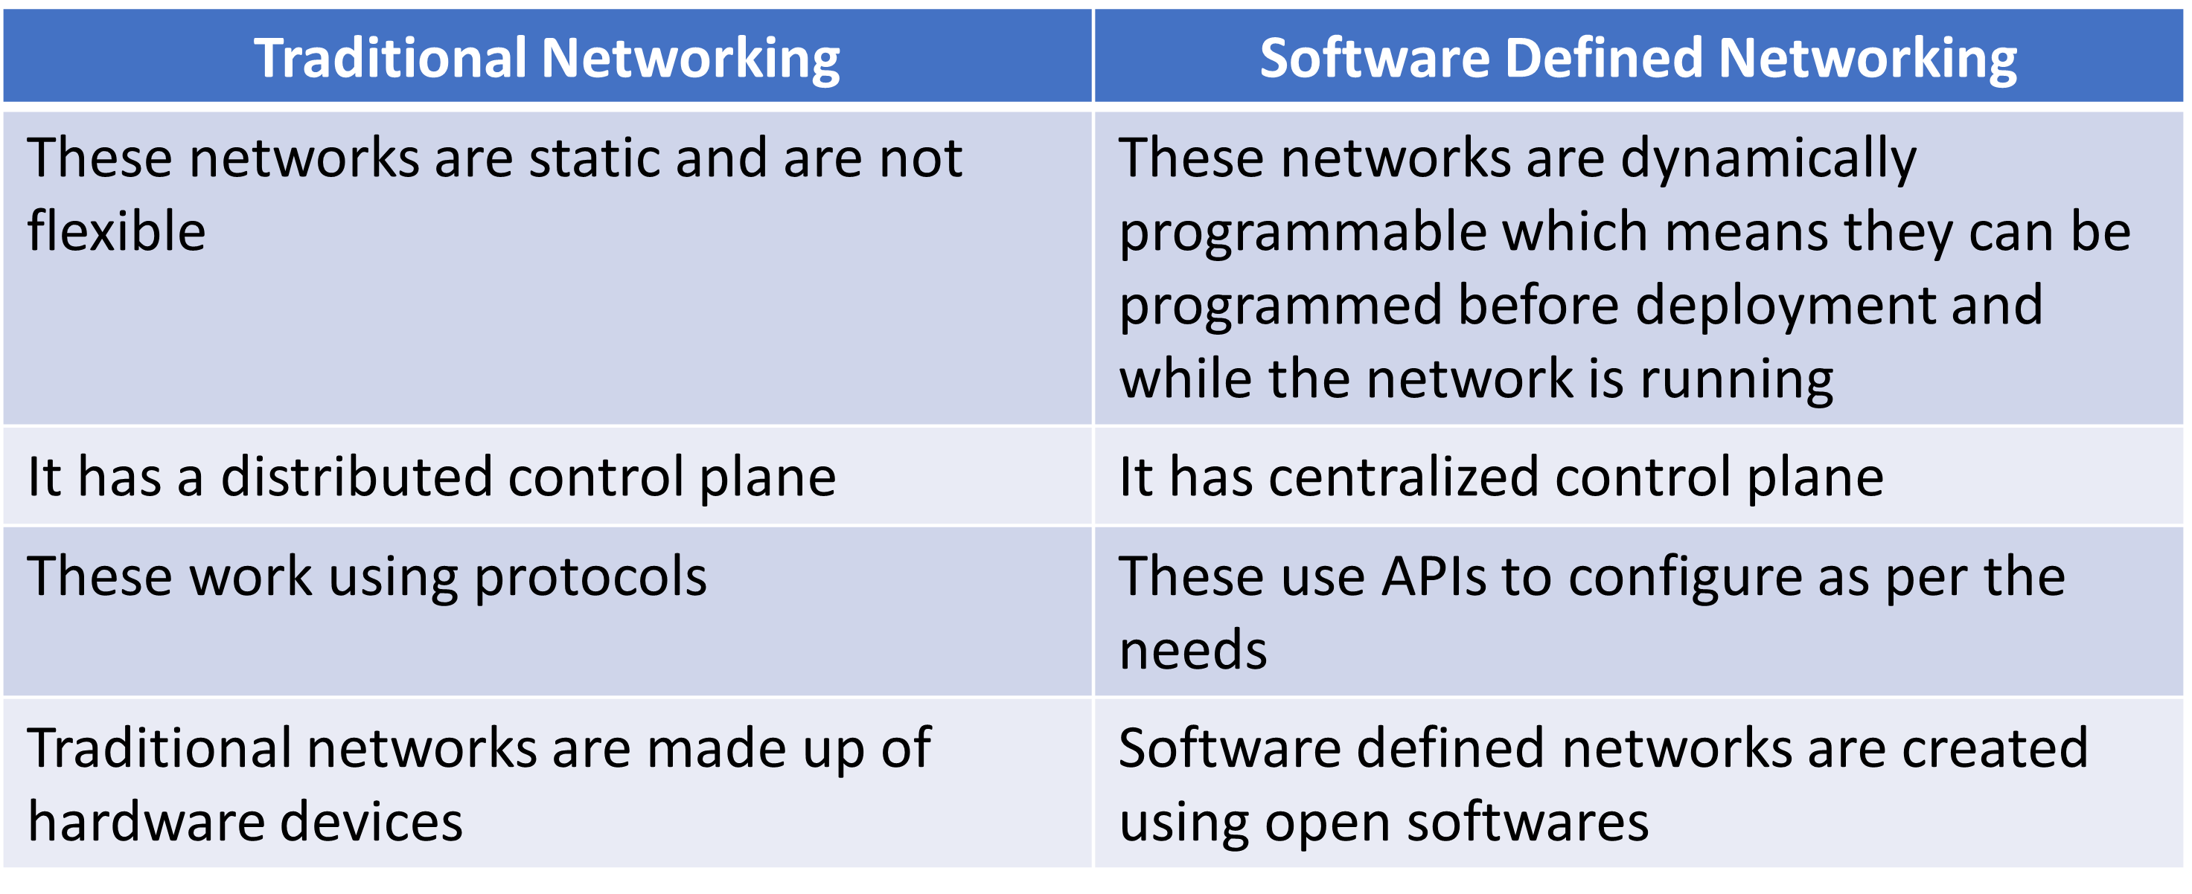
Difference Between Them

Slide 5

Why Load Balancing ?
Unusual traffic causing Packet Loss

Slide 6
Other aspects of Load Balancing
Improve QoS metrics
Transmission latency
Resource Utilization
Avoiding bottlenecks
Minimize Response Time
Resource allocation
Maximize Throughputs

Slide 7
Existing Works
Year | Paper Name | Controller used | Algorithm used | Simulation/Real enviroments | SLB/DLB/MLB/ MetaLB | Outcomes
2010 | Uppal, H., Brandon, D., 2010. OpenFlow based load balancing. CSE561: Networking Project Report, University of Washington, 2010 | NOX | Load-based, Random , Round-robin | Real enviroment | Static LB | This study allows only one controller to manage a switch. A single point of failure (SPOF)
2014 | Li, J., Chang, X., Ren, Y., Zhang, Z., Wang, G., 2014. An effective path load balancing mechanism based on SDN, in: Trust, Security and Privacy in Computing and Communications (TrustCom), 2014 IEEE 13th International Conference on, IEEE. pp. 527–533 | POX | FSEM, Top-k paths | Mininet | Meta LB | FSEM proposed for selecting shortest Top-k paths Utilizes Top-k algorithm based on hop count for path removal
2015 | Kaur, S., Kumar, K., Singh, J., Ghumman, N.S., 2015. Round-robin based load balancing in software defined networking, in: Computing for Sustainable Global Development (INDIACom), 2015 2nd International Conference on, IEEE. pp. 2136–2139 | POX | Load-based, Random , Round-robin | Mininet | Static LB | Proposed an algorithm for load balancing based on SDN. Results shown that the round-robin algorithm is better than a random algorithm.
2017 | Zhong, H., Fang, Y., Cui, J., 2017a. Lbbsrt: An efficient SDN load balancing scheme based on server response time. Future Generation Computer Systems 68, 183–190 | Floodlight | LBBSR | Mininet | Dynamic LB | This approach did not consider energy savings in server LB.
2019 | da Silva, L.S., Storck, C.R., de LP Duarte-Figueiredo, F., 2020b. A dynamic load balancing algorithm for data plane traffic | OpenDayLight | Dynamic LB | Mininet | Dynamic LB | Technique identifies shortest paths and calculates connection costs Uses network equipment data to locate and address bottlenecks, optimizing packet routes based on traffic flow
2019 | Chahlaoui, F., El-Fenni, M.R., Dahmouni, H., 2019. Performance analysis of load balancing mechanisms in SDN networks, in: Proceedings of the 2nd International Conference on Networking, Information Systems & Security, pp. 1–8. | POX | LB for data plane | Mininet | Other LB | Study compared jitter and delay across different controllers Controllers included hub-like, augmented with STP, and LB controller
2020 | Rupani, K., Punjabi, N., Shamdasani, M., Chaudhari, S., 2020. Dynamic load balancing in software-defined networks using, in: Proceeding of International Conference on Computational Science and Applications: ICCSA 2019, Springer Nature. p. 283 | Floodlight | BPANN | Mininet | Meta LB | Research utilized BPANN algorithm Method incorporates features like packet loss rate, bandwidth utilization, transmission hops, latency, and node utilization

Slide 8
Objective
Implement Round Robin algorithm for dynamic traffic distribution.
Utilize timer-based task execution for periodic flow rule adjustment.
Apply switch-specific flow control for tailored traffic routing.
Evaluate performance metrics including scalability and latency.

Slide 9
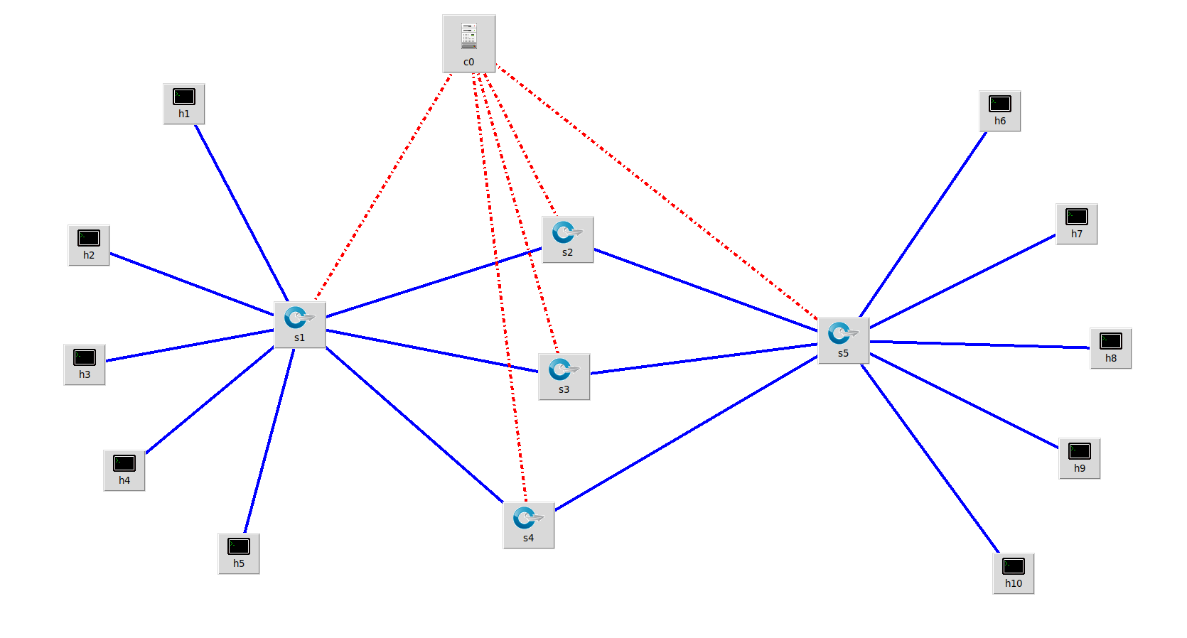
Proposed Architecture
S(x)_eth (y)
Port numbers
After every 5 seconds the path will change
S1_eth1
S2_eth1
S2_eth2
S5_eth1
S1_eth2
S1_eth6
S5_eth2
S5_eth6
S1_eth3
S1_eth7
S5_eth7
S5_eth3
S1_eth8
S3_eth1
S3_eth2
S5_eth8
S5_eth4
S1_eth4
S5_eth5
S1_eth5
S4_eth1
S4_eth2
Path 1
Path 1
random.randint(90,130)
Path 2
random.randint(30,90)
Weights
Path 2
Path 3
random.randint(0,10)
Path 3

Slide 10
Implementation of Round Robin Algorithm
Change Flow Function:
Adjusts how data flows through the network based on what's happening.
Looks at where data is coming from and going to, and decides how to send it.
Makes sure data goes between certain ports in a specific order, like taking turns between two specific ports.
Task Pout Functions:
Handles tasks to manage how data moves around the network.
Checks regularly to see if any adjustments are needed in how data is sent.
Makes sure data is sent evenly across different paths in the network.
MyComponent Class:
The main part that manages what happens when the network connects.
Sets up how data should flow when the network starts.
Sets timers to do regular checks and make changes as needed.
Flow Rule Addition Function:
Adds instructions to the network on how to handle data.
Decides which data should go where and how it should be treated.
Sends these instructions to the network so it knows what to do.
Timer Initialization Function:
Sets up timers to keep track of time and trigger actions.
Makes sure tasks happen regularly, like checking and adjusting how data is handled.

Slide 11
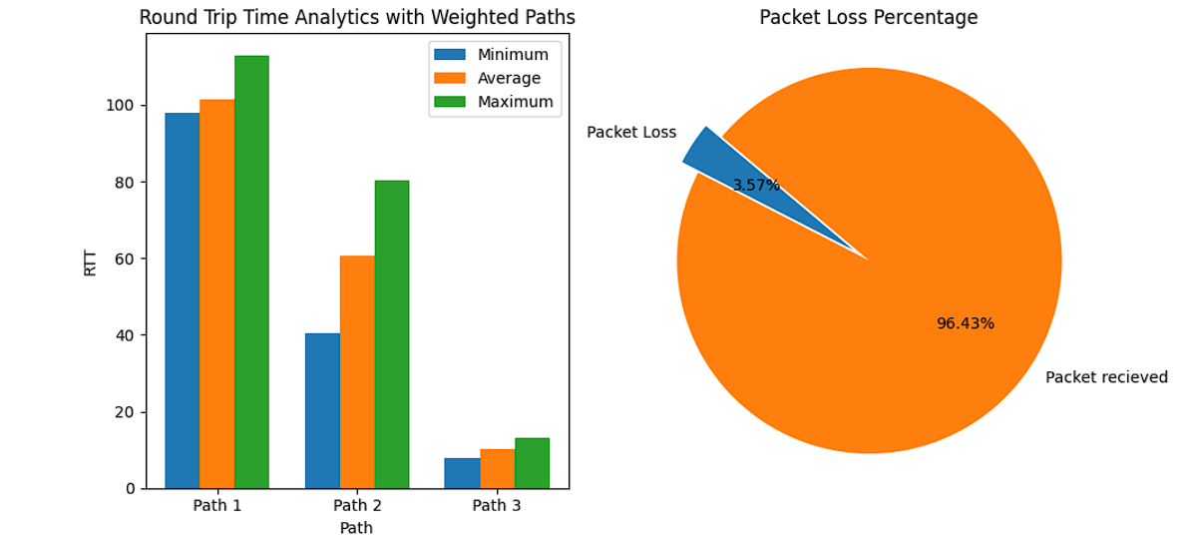
Results and Analysis
Without Round Robin Algorithm packet loss will be much higher

Slide 12
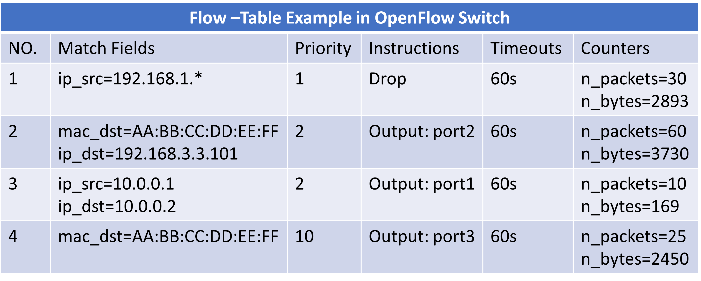


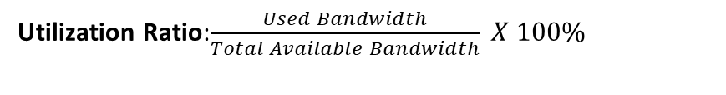
Future Work
Apply Back Propagation Artificial Neural Network (BPANN) to analyze path information (BWRatio, PLoss, Latency, Hop count) for optimized traffic routing.
Bandwidth:$\frac{Amount of Data}{Time Taken}$
Utilization Ratio:$\frac{Used Bandwidth}{Total Available Bandwidth} X 100\%$
Packet Loss Ratio:$\frac{Number of Packet Lost}{Total Number of Packets Sent} X 100\%$
Transmission Latency: End Time – Start Time
Other metrics
Transmission Hops: Number of Intermediate Devices

Slide 13
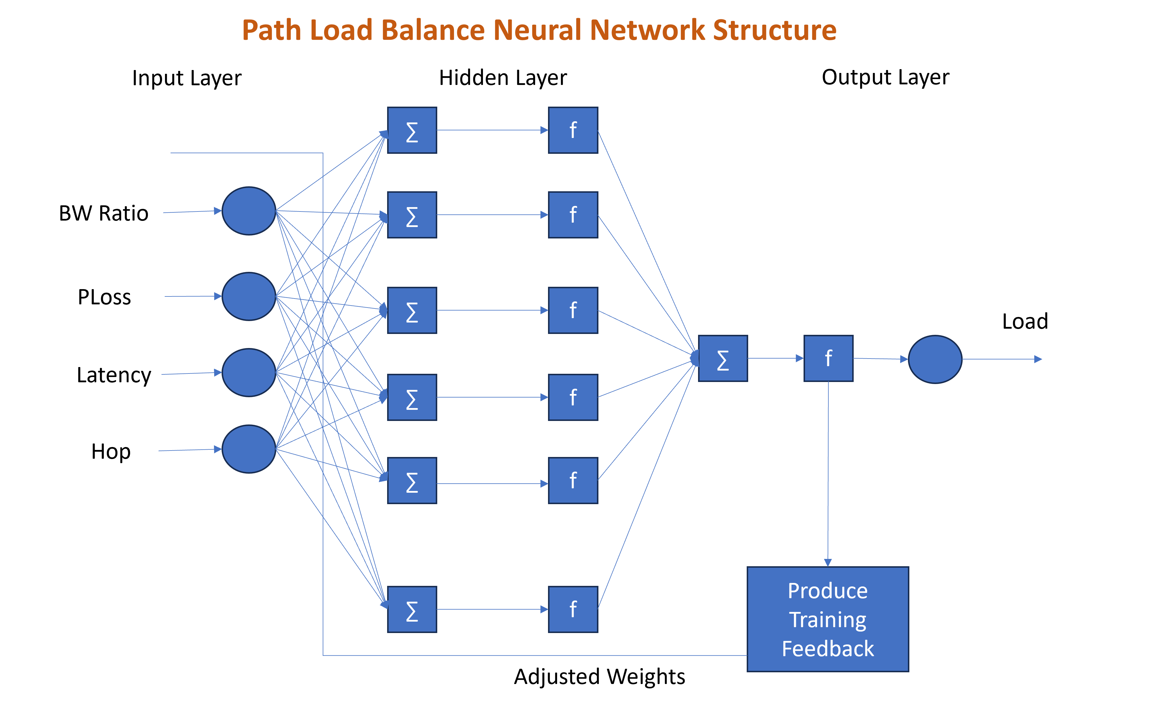
Develop Neural Network structure with input (path features), hidden (optimized neurons), and output (selected path) layers.
We can ping h1 to h2
Topology
Paths are changing after an interval of time
Evaluate BPANN performance against Round Robin.
Compare metrics: BWRatio, PLoss, Latency, Hop count.
Analyze impact on network performance, scalability, and responsiveness.

Slide 14
Thank You

